Slide 2

Santhosh Kumar (Sandy)
Data Engineer, Cognizant
Microsoft Certified Trainer
3 Azure Hackathon winner

Slide 3
Make payments from inside Microsoft Teams
By Santhosh Kumar

Slide 4
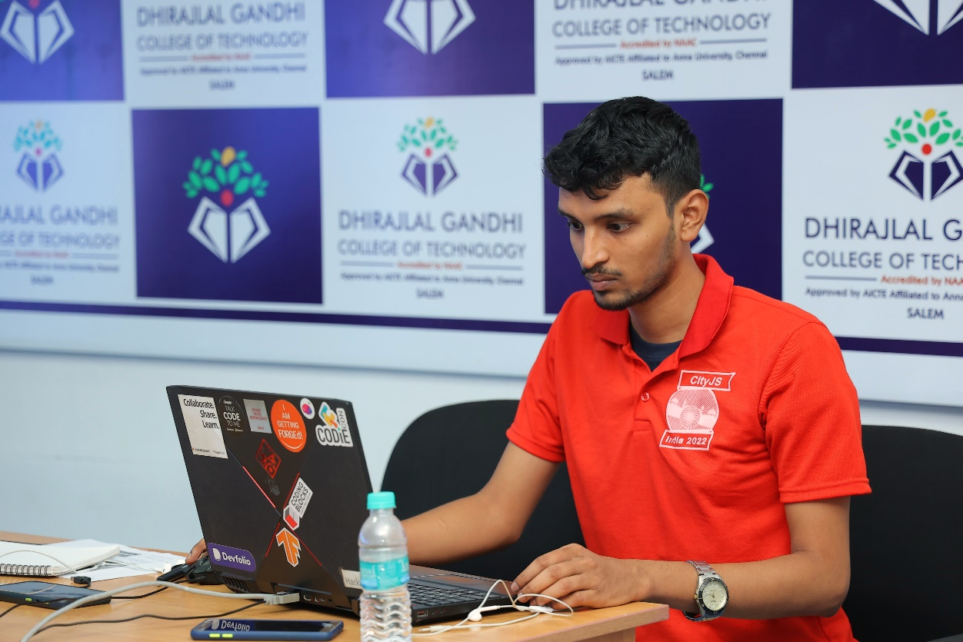
About Me
Working as a Data Engineer (Core Python)
3rd Prize in Citi Digital Innovation Challenge 2022 (~$2000)
Winner of Deepgram X DEV Hackathon 2022 ($1500)
Winner of Microsoft Azure Trail Hackathon 2022 ($1500)
Winner of Azure Developer Stories 2021 (Microsoft Surface Pro X)
Winner of Azure Community Conference 2021 – Hackathon (Microsoft Surface Go 2)
Microsoft Certified Trainer 2021-2022, 2022-2023
Microsoft Certified Professional with six Azure certifications
Azure Developer Community Lead – Chennai Region
I love helping and talking to like-minded people
Participated in 10+ hackathons

Slide 5
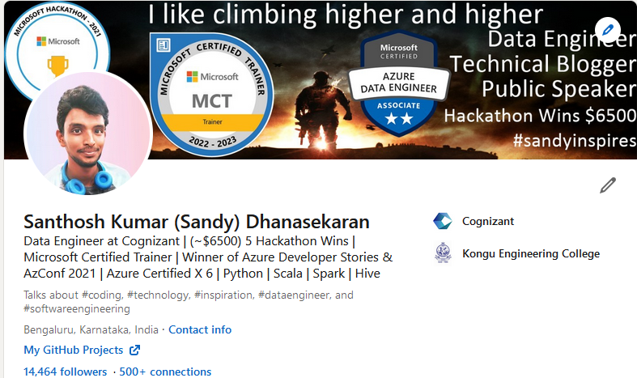
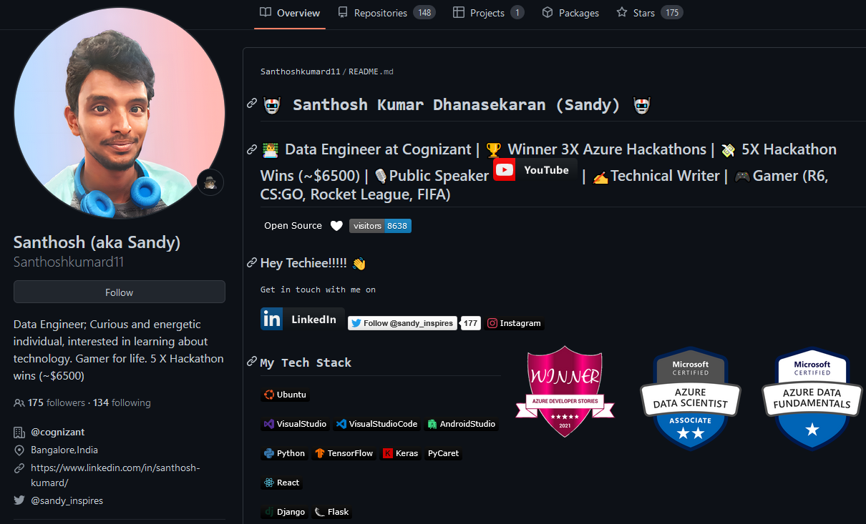
Profile – Sandy Inspires

Slide 6

Weekends…

Slide 7
Random Fact
Azure Community Conference 2020 – was listening to speakers
Azure Community Conference 2021- Won 1st prize in AzConf Hackathon
Finally, I’m speaking at Azure Community Conference 2022 today!

Slide 8
Agenda
Why on Teams and what it offers?
Architecture of the solution
Azure Services Used
Live Demo
Open for questions

Slide 9
Microsoft Teams
Two years after its launch, Teams generated $800 million in revenue.
Teams recorded 700% YoY revenue increase in 2020.
The pandemic helped Microsoft Teams attract 44 million users in just six months.
Users spent 2.7 billion minutes in meetings on Microsoft Teams in March 2020.
100 million students use Microsoft Teams as one of their learning tools.
In 2021, the platform had 115 million daily active users.
Teams started out 2022 with 270 million monthly users.

Slide 10
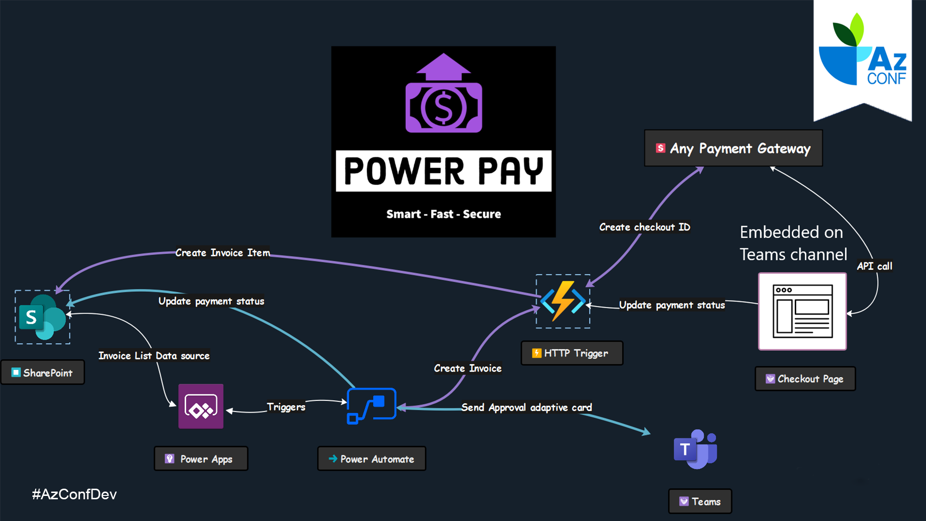

Slide 11
Azure Services Used
Power Apps - a No/Low code platform
Power Automate - Workflow automate
Adaptive Card - seamless integration with Power Automate
Azure Function - Runs Python code to manage all the backend services for robust usage
SharePoint - using it as a database for storing data

Slide 12
Let’s swing into action! Shall we!
Source code on GitHub - github.com/Santhoshkumard11/power-pay-with-Rapyd

Slide 13

Platinum Partner

Slide 14

Q&A
Connect with me
LinkedIn - linkedin.com/in/santhosh-kumard/
GitHub – github.com/Santhoshkumard11 Twitter – sandy_inspires Instagram – sandy_inspires

Slide 15
Thank You!
Make payments from inside Microsoft Teams
Santhosh Kumar Dhanasekaran
Data Engineer, Cognizant

